Slide 1
The Emergence of Industrial America
During the first half of the nineteenth century, acquiring and developing new territories occupied most of the nation’s energies. After the Civil War, Americans built on foundations of industrialization laid by Alexander Hamilton’s financial program, Henry Clay’s American System, and Abraham Lincoln’s efforts to transform the minority Republican Party into a major political force.

Slide 2
Review of Earlier Programs that Promoted Industrial Growth and Regional Specialization

Slide 3
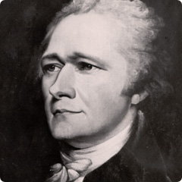
Hamilton. Through his funding program, he established the credit of the federal government and increased its credibility. His national bank provided for a stable currency, and his proposed protective tariff would have cushioned new manufacturers from foreign competition.

Slide 4
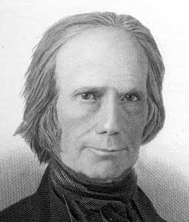
Clay’s American System. Clay furthered the government’s active role in fostering economic enterprise by enacting the protective tariff Hamilton had envisioned, rechartering the bank, and funding internal improvements to bind the sections of the country through roads and canals.

Slide 5
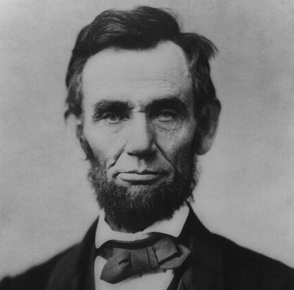
Abraham Lincoln. His election platform, which was designed to broaden his base of political support, was enacted during the war years when Southern Democrats were not represented in Congress. The high Morrill Tariff, provision for a transcontinental railroad, Contract Labor law, National Banking Act, and the Homestead Act helped lay a strong foundation for industrialism by reducing foreign competition, connecting the East and West, and allowing for the importation of cheap foreign labor, providing a found national currency, and building a wider national market for American industrial products.

Slide 6

The Emergence of Industrial America
A new nationwide economic system soon replaced local markets, and by 1900, the United States had become the world’s foremost industrial giant with all the possibilities and problems such status implies

Slide 7
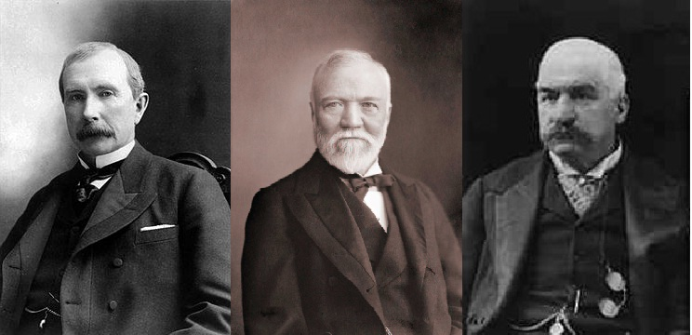
The Emergence of Industrial America
Industrialism soon permeated every aspect of American life. The country—or at least its wealthier citizens—came to enjoy a standard of living unimaginable a few years earlier.

Slide 8
The Emergence of Industrial America
At times, change did not seem to constitute progress. Turmoil seemed constant as the nation grappled with problems of
1) materialism
2) urbanization
3) social conflict
4) impersonalization
5) corruption in business and government
6) a new position of power in the world.
Efforts continue today to resolve issues stemming from this rise of industrialism.

Slide 9


Ingredients for Industrialization
Countries go through periods of industrialization. China is the most current example:

Slide 10
What were the ingredients necessary for the emergence of Industrial America in the late 19C?

